Slide 1














BRIEFING
Enterprise architecture governance relies on tacit expert judgement.
Explicit Governance
Tacit Judgement
Documented Policies & Standards
Situational Decision Logic
Compliance Checklists
Undocumented Experience
Fixed Decision Criteria
Fragile & Hard to Transfer
Integrated Artifacts
THE GAP
Existing EA governance tools enforce rules but don't externalise the tacit judgment behind them. The TEAF framework closes that gap by mapping knowledge management techniques onto AI mechanisms (prompt engineering as the tacit externalisation channel, RAG as the explicit channel).

Slide 2
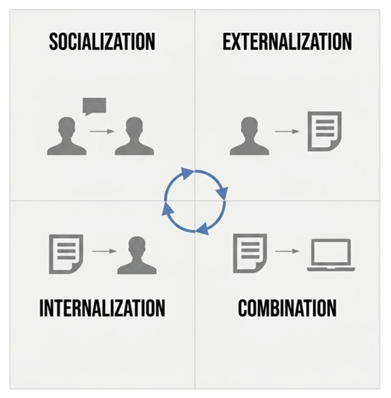
BRIEFING
The SECI Model
SOCIALIZATION = Tacit -> Tacit EXTERNALIZATION = Tacit -> Explicit COMBINATION = Explicit -> Explicit INTERNALIZATION = Explicit -> Tacit

Slide 3

BRIEFING
STEP 2 Externalisation of the internalised tacit knowledge into system prompt patches (prompt engineering as the act of externalisation).
The SECI Model
STEP 1 Agent extracts tacit knowledge during the conversation with the practitioner.

Slide 4



BRIEFING
Guide the participant by coaching and externalise tacit knowledge at runtime
1. Dialogue Practitioner and Agent talk to each other
2. Tacit Externalisation Agent creates system-prompt patch proposals
3. Review & Approval Human reviews and approves/ rejects system-prompt patches
4. Patch Agent Patch system-prompt and update behaviour
The coaching agent guides you through domain topics in real-time taking over coaching, facilitating or consulting roles.
The coaching agent internalises tacit knowledge at runtime and externalises it towards itself and the domain agent.
Main Research Contribution: Mapping AI techniques to Knowledge Management mechanism to capture tacit knowledge and making it explicit.
TWO-AGENT ARCHITECTURE
Coaching Agent
Domain Agent
Dialogic guidance for EA decision processes.
Retrieval & anomaly detection across portfolios.

